Slide 1
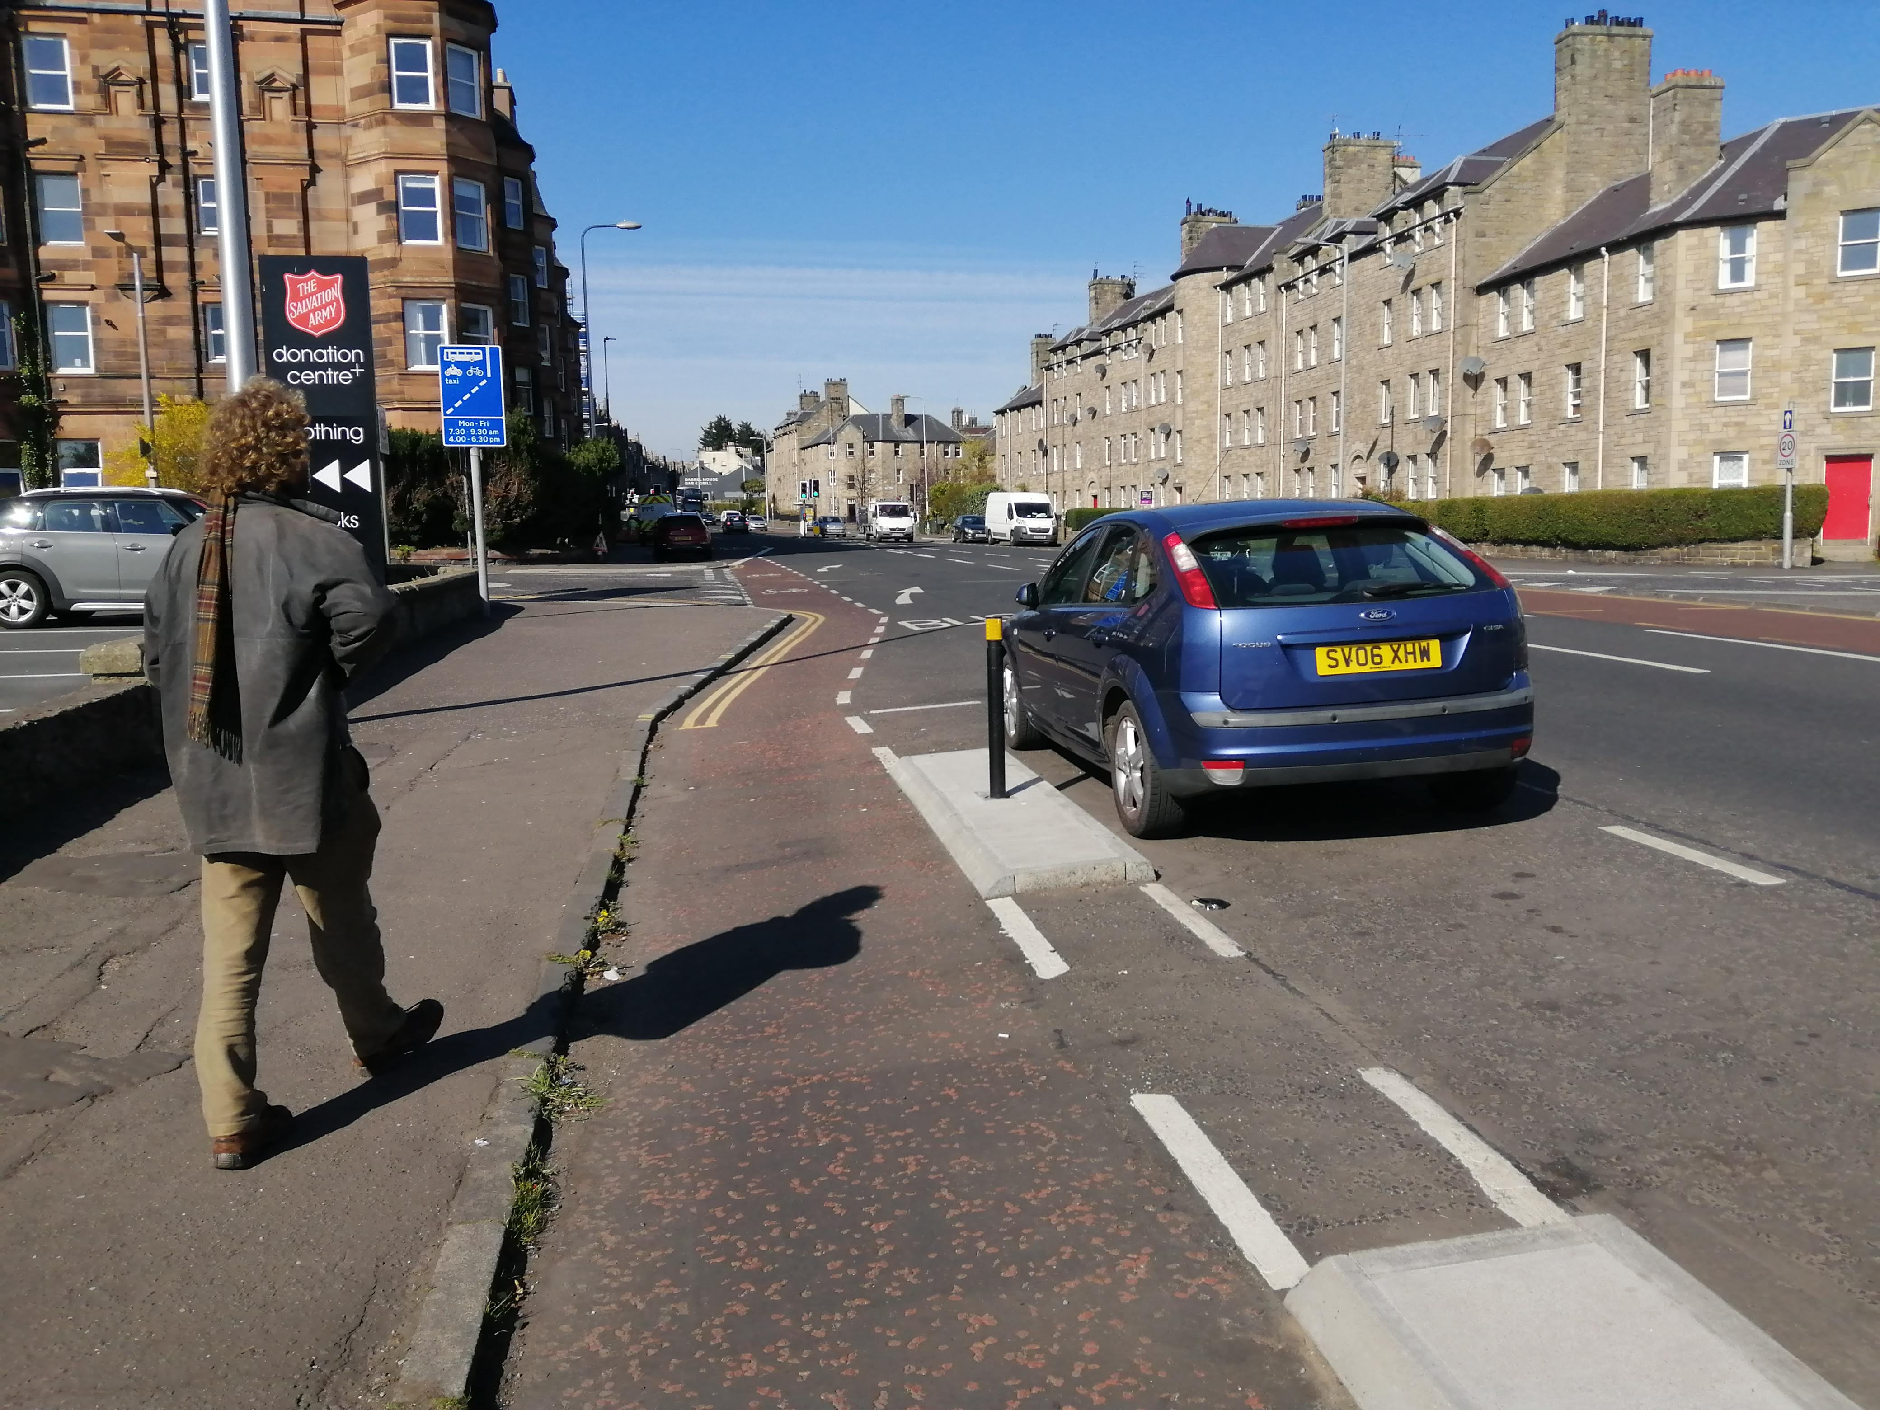

The Saferactive Project
Road safety research for active travel
Joey Talbot

Slide 2
Contents
1. Data Sources
2. Regional trends
3. Sub-regional trends
4. Road type and LTNs – West Yorkshire case study
5. Conclusions
Notes:
I’ll start regional, then steadily go down to smaller levels of geographic resolution

Slide 3
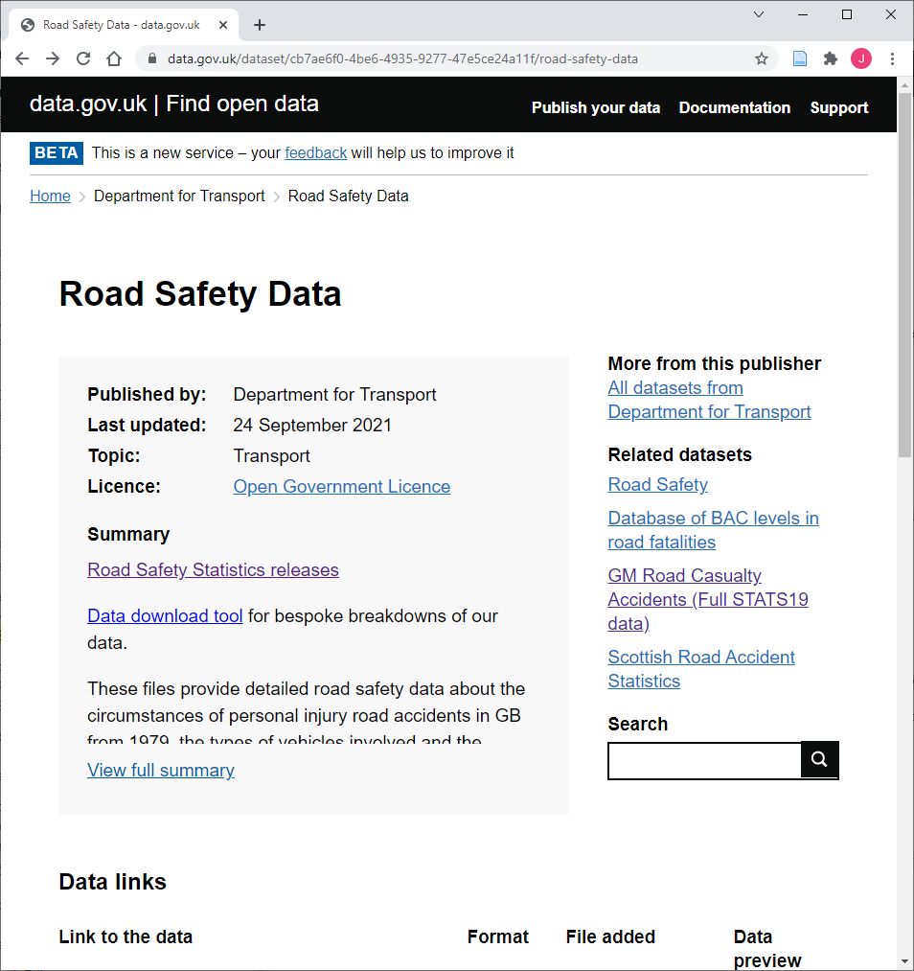
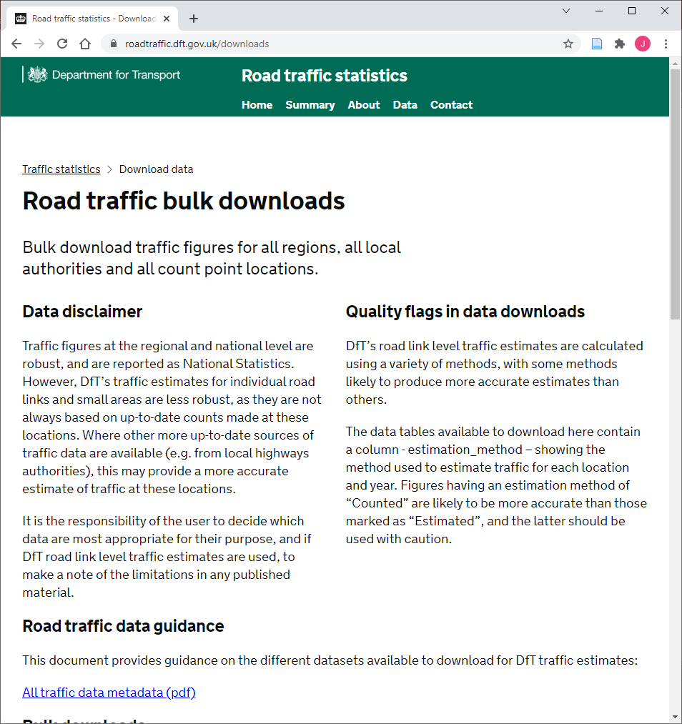
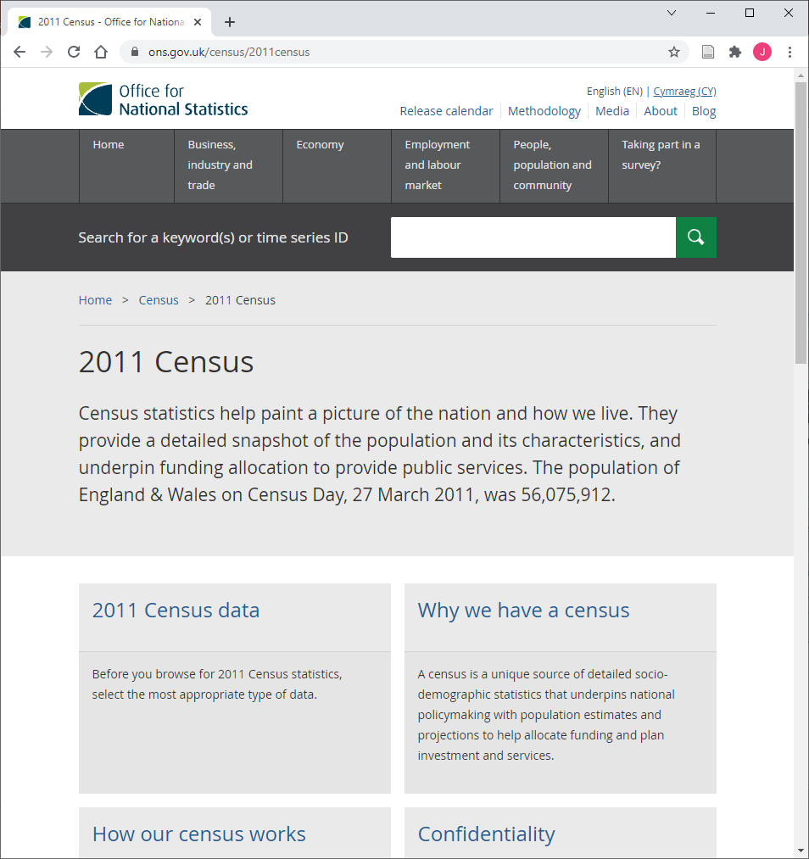
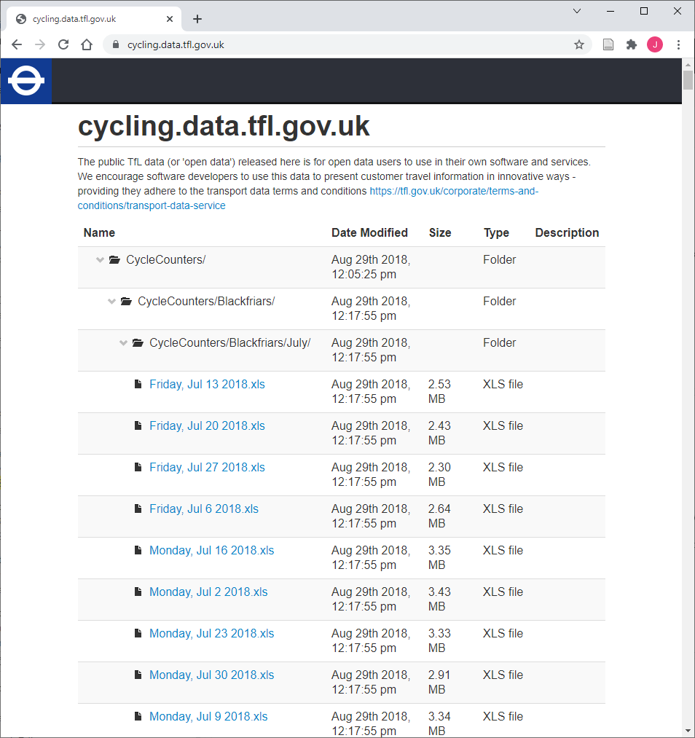
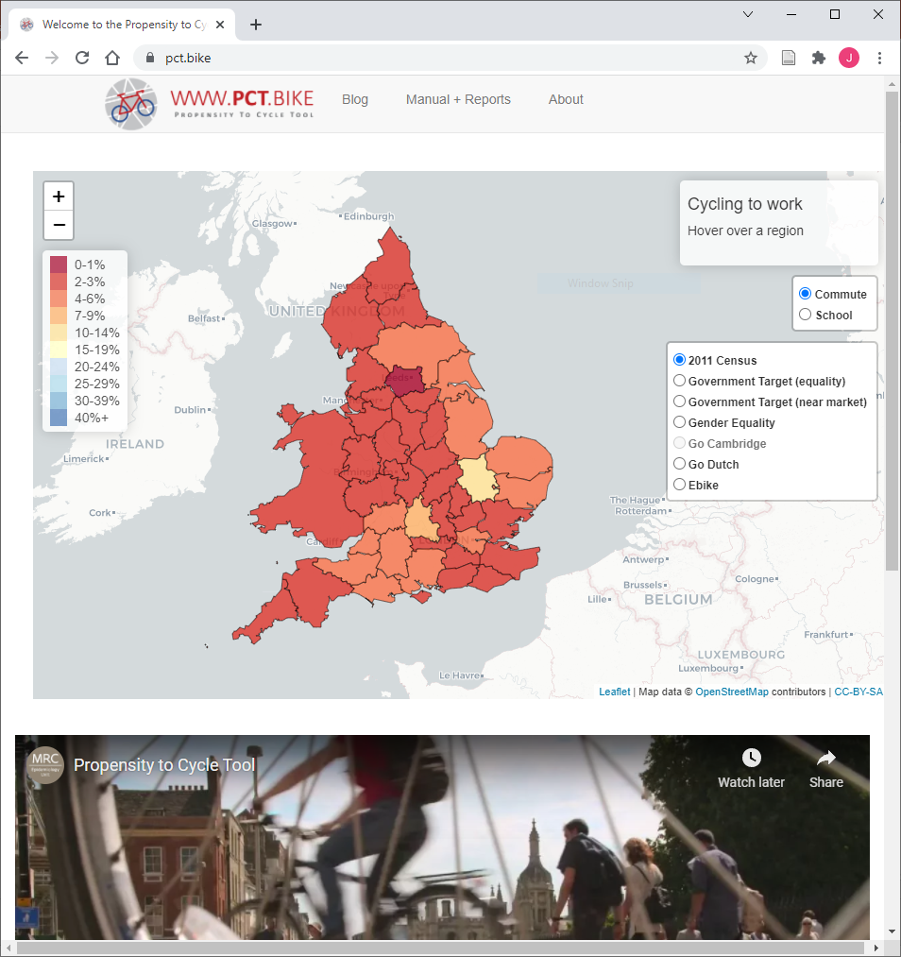
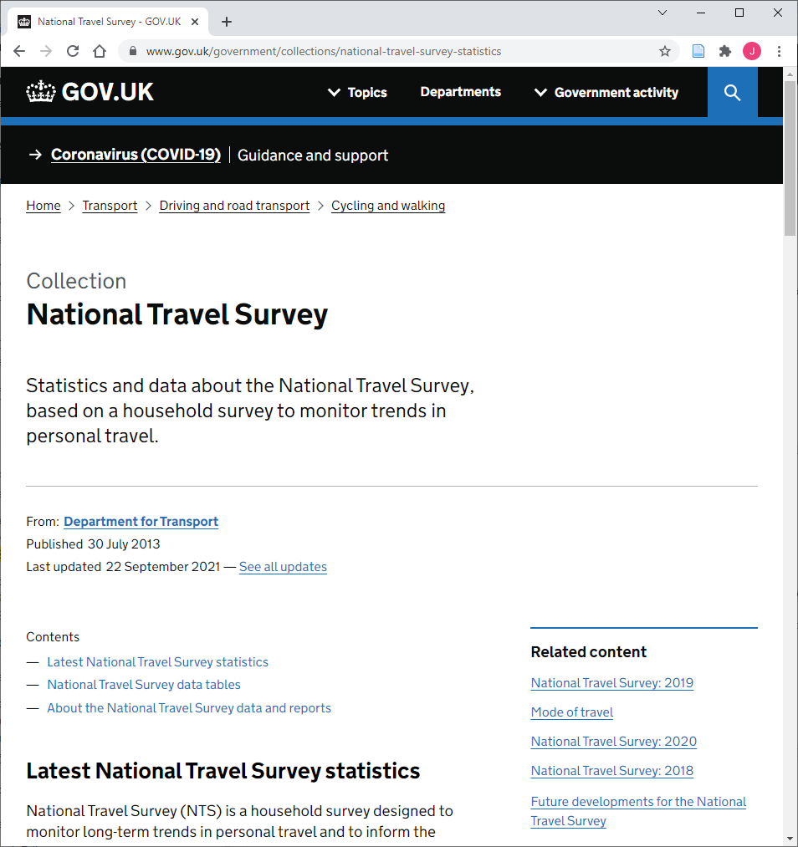
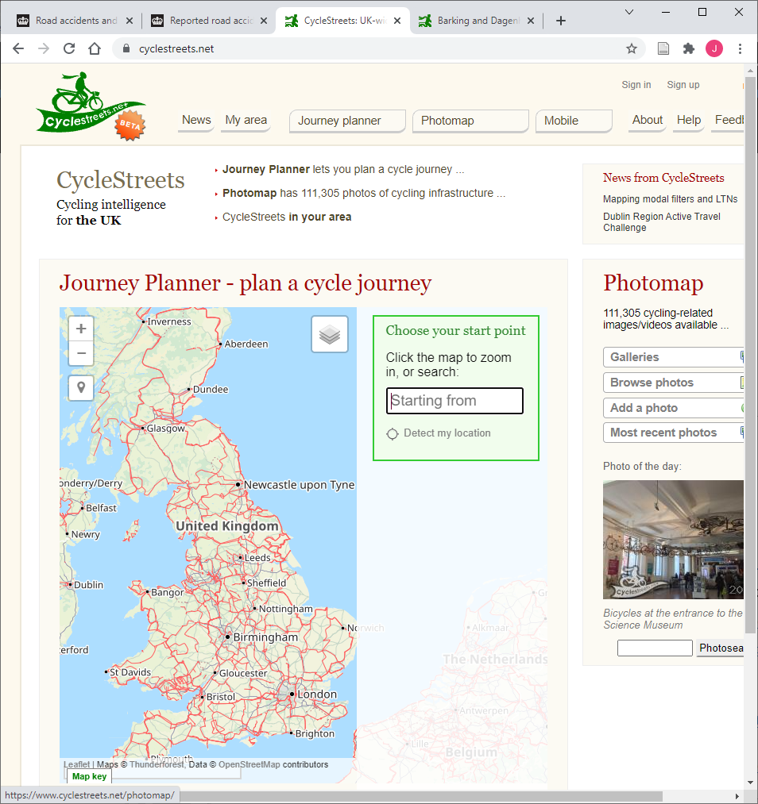
1. Data Sources

Slide 4
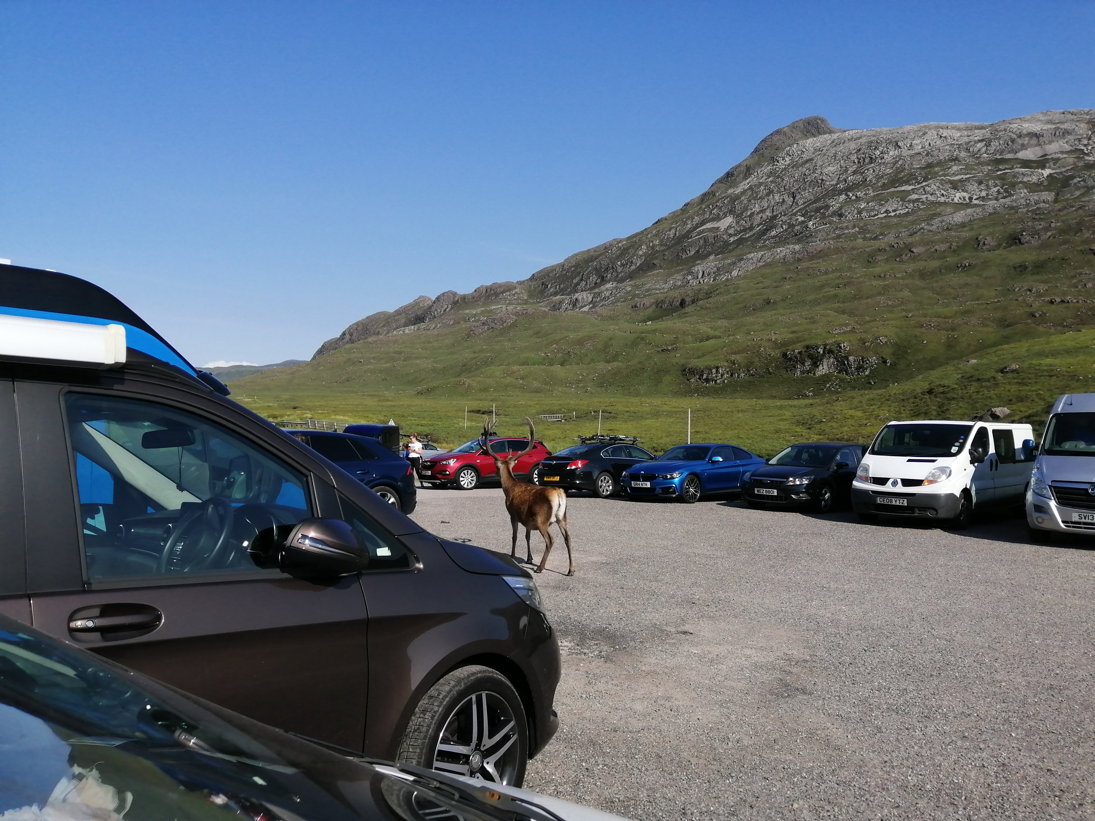
2. Regional Trends
Notes:
Regional trends – use stats19, DfT regional and count, and NTS data

Slide 5
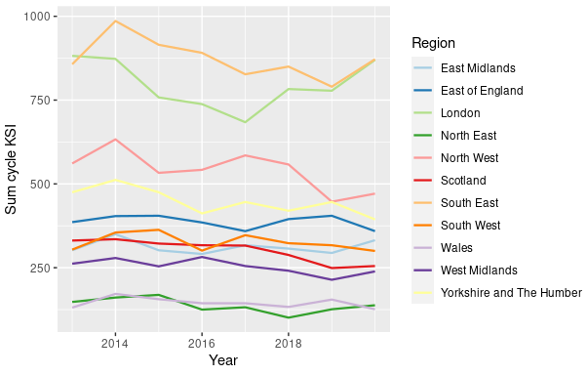
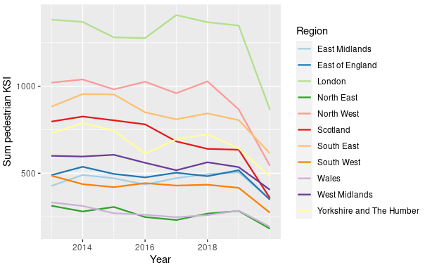
Road users killed or seriously injured, 2013 – 2019
Cyclists
Pedestrians
9% fall in KSI, 2013 - 2019
3% rise in KSI, 2019 - 2020
8% fall in KSI, 2013 - 2019
32% fall in KSI, 2019 - 2020

Slide 6
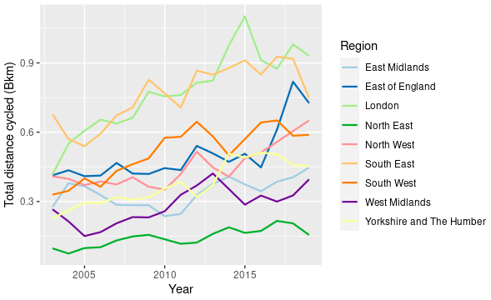
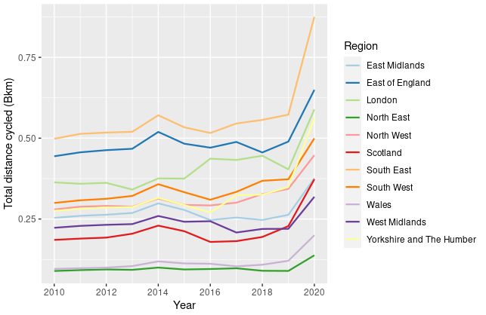
Total distance cycled per region
NTS Survey (2003 – 2019)
DfT Regional traffic (2010 – 2020)

Slide 7
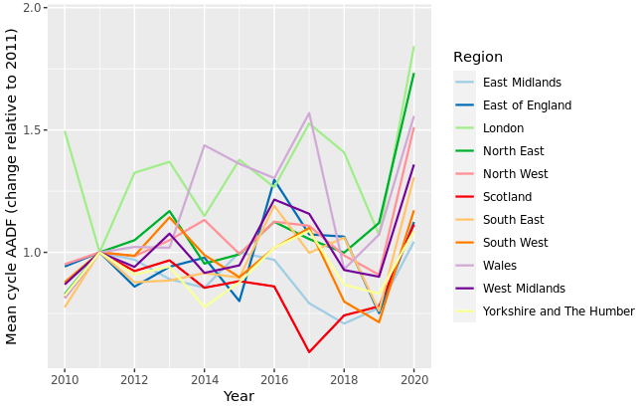
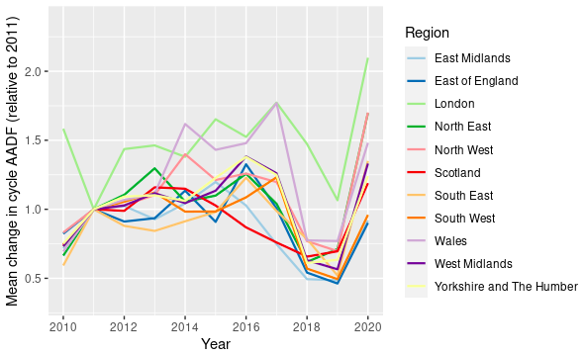
Change in mean AADF cycle flow per region, 2010 - 2020, based on DfT counters
Based on mean counts
Based on change in counts

Slide 8
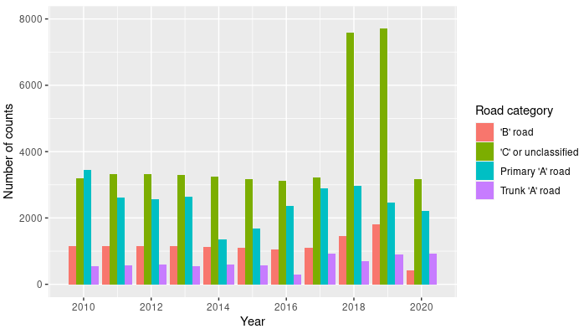
Road types in the DfT counter set

Slide 9
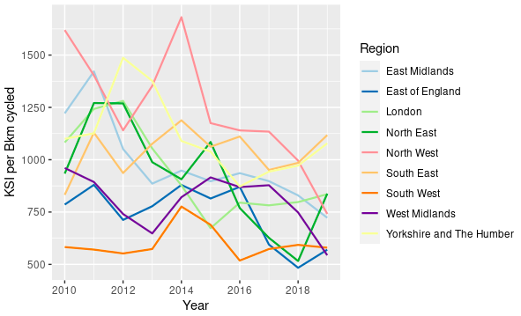
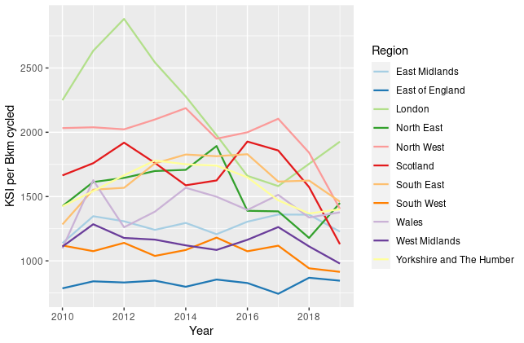
KSI per Bkm cycled, 2010 - 2019
Based on NTS data
Based on DfT regional traffic data
29% fall in KSI per Bkm, 2011 - 2019
17% fall in KSI per Bkm, 2011 – 2019 (excl. Scotland and Wales)
Scotland sees a 36% fall

Slide 10
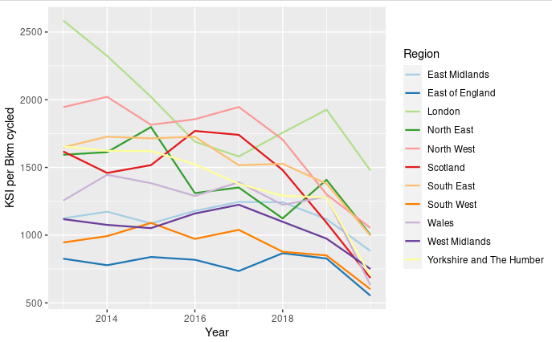
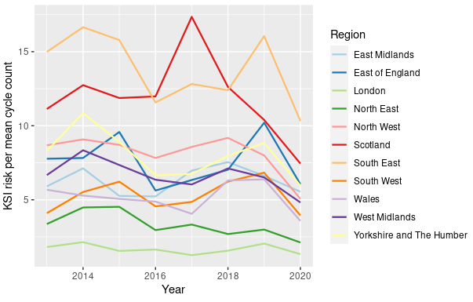
KSI per Bkm cycled, 2013 - 2020
Based on DfT regional data
Based on DfT counter data
30% fall in KSI per Bkm, 2019 - 2020
34% fall in KSI per Bkm, 2019 - 2020
Notes:
Ignore the scale and the order of the regions on the second graph; the important thing is the annual change

Slide 11
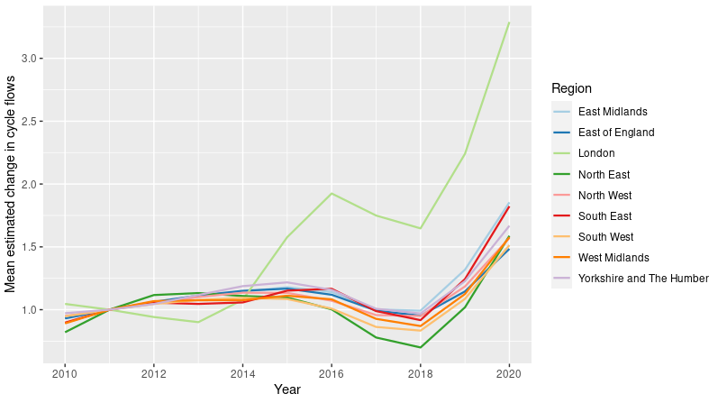
GAM predicted change in cycle flows, 2010 - 2020

Slide 12
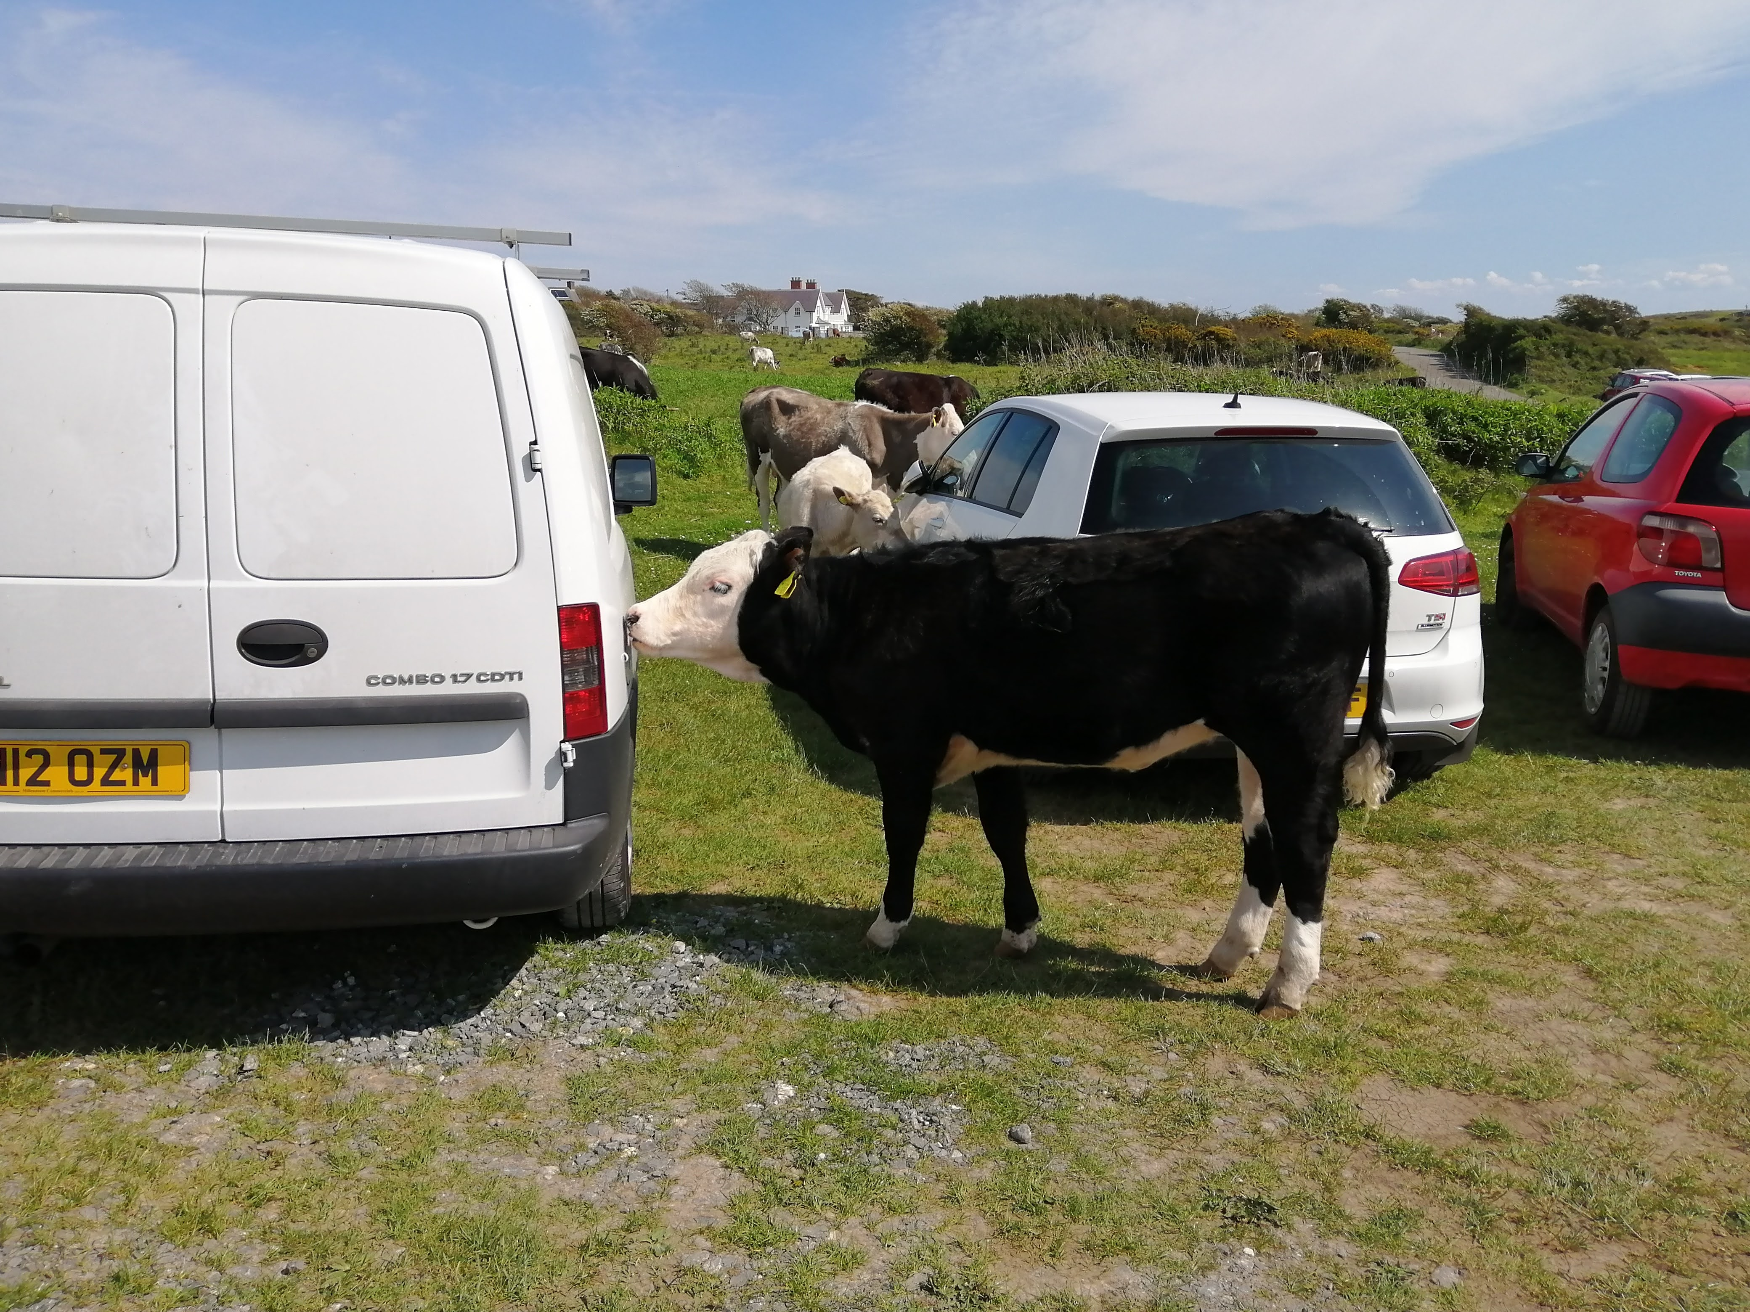
3. Sub-regional trends
Notes:
Sub-regional trends – use census 2011, PCT, Cyclestreets, for 2011 baseline, and DfT counters for annual changes.
Unlike the previous graphs, the total cycling km and KSI are based on peak hours only.

Slide 13
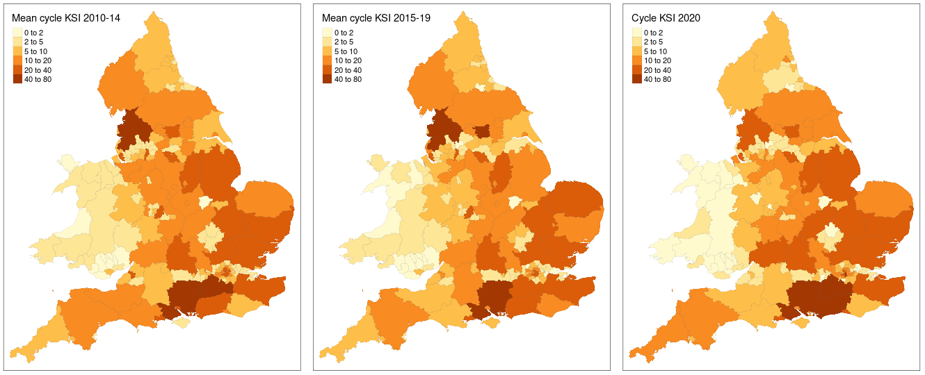
Cyclists killed or seriously injured during the AM and PM peak hours, by Upper Tier LA
Notes:
The 2020 stats19 data doesn’t allow peak hours to be specified, so I just took the % change from 2019 in total casualties. The proportion of these occurring in the peak hour was probably lower in previous years (leisure cycling more important than commuting in 2020), so this is probably an overestimate of peak hour KSI in 2020.
Missing Scotland because it doesn’t have PCT.

Slide 14
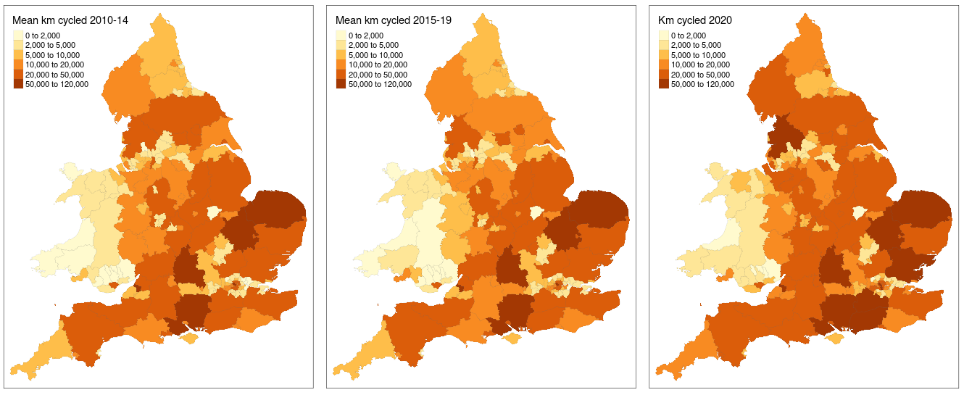
Km cycled for travel to work, by Upper Tier LA
Notes:
The km cycled in 2011 is obtained from Census data, using the PCT to derive a route network which forms an estimate of the number of journeys to work. For all other years, the 2011 data are adjusted using AADF from DfT traffic counters. To reduce variability, the three years 2010-2012 are averaged for 2011 flows. Eg in 2020, the difference between AADF in 2020 and the mean AADF in 2010-2012 is used to calculate the % change in km cycled from 2011 to 2020.

Slide 15
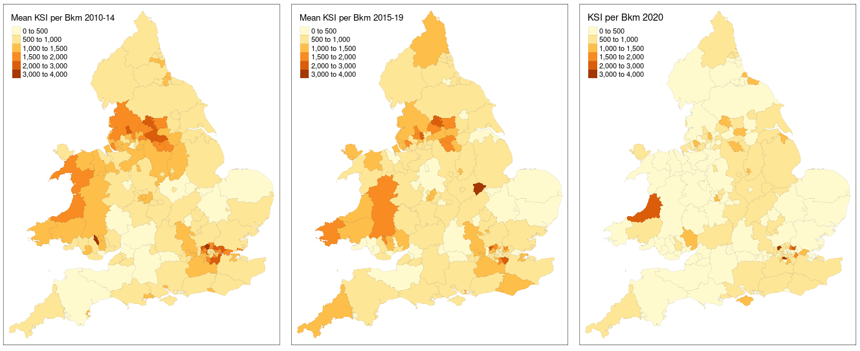
KSI per Bkm cycled for travel to work, by Upper Tier LA

Slide 16
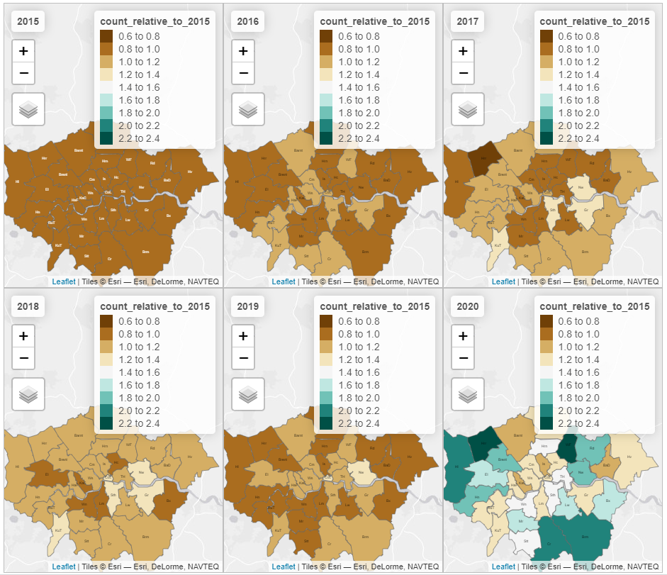
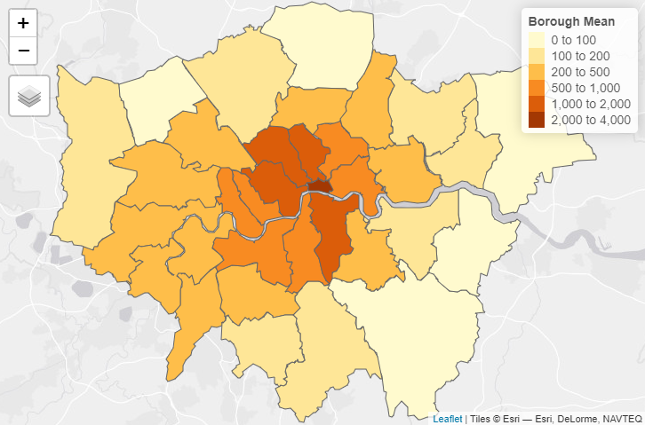
TfL count data
Change in TfL cycle counts
Mean TfL cycle count 2015 - 2020

Slide 17
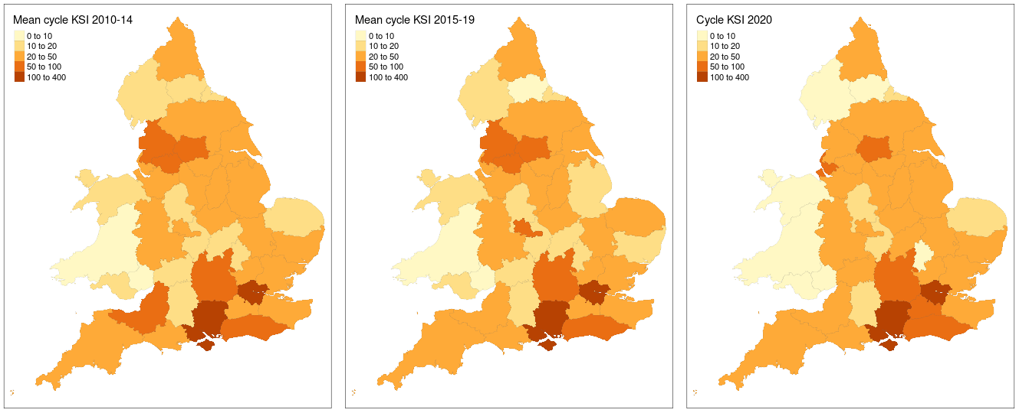
Cyclists killed or seriously injured during the AM and PM peak hours, by Police Force

Slide 18
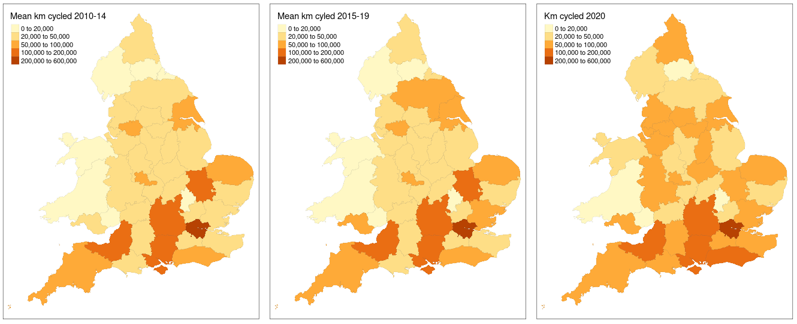
Km cycled for travel to work, by Police Force

Slide 19
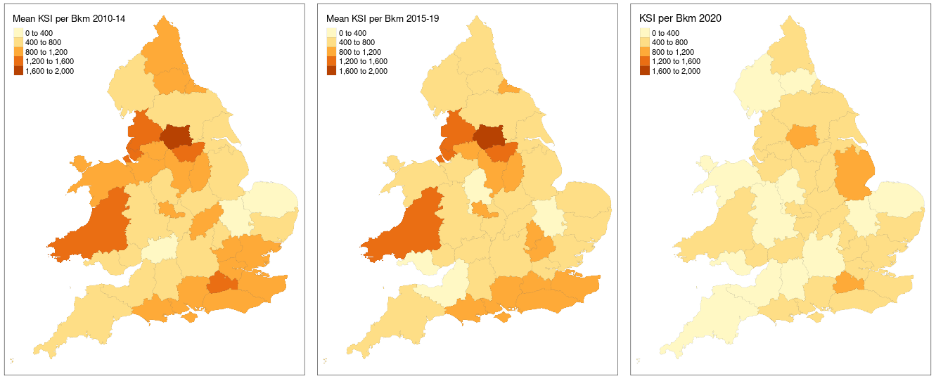
KSI per Bkm cycled for travel to work, by Police Force

Slide 20
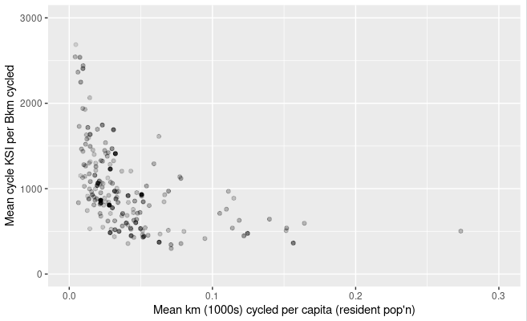
A safety in numbers effect?
Cycle KSI risk against mean km cycled per capita (2010 – 2019) for Local Authorities; weighted by 2015 population
Notes:
Of course, this doesn’t tell us about casuality. Maybe more people cycle when places feel safer.

Slide 21
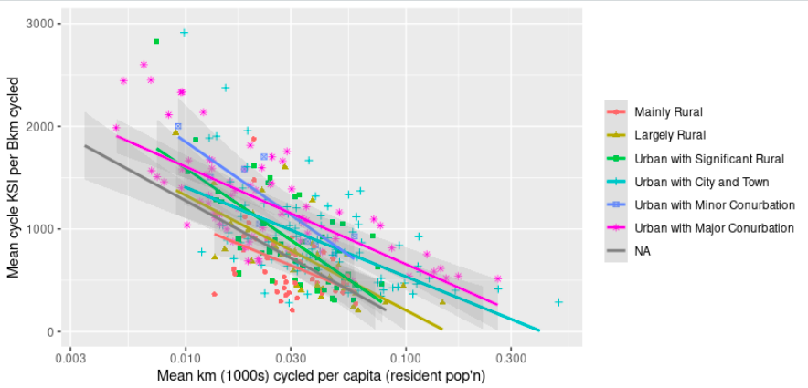
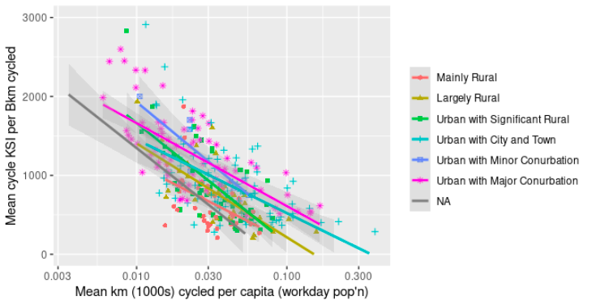
Safety in numbers and rural-urban status

Slide 22
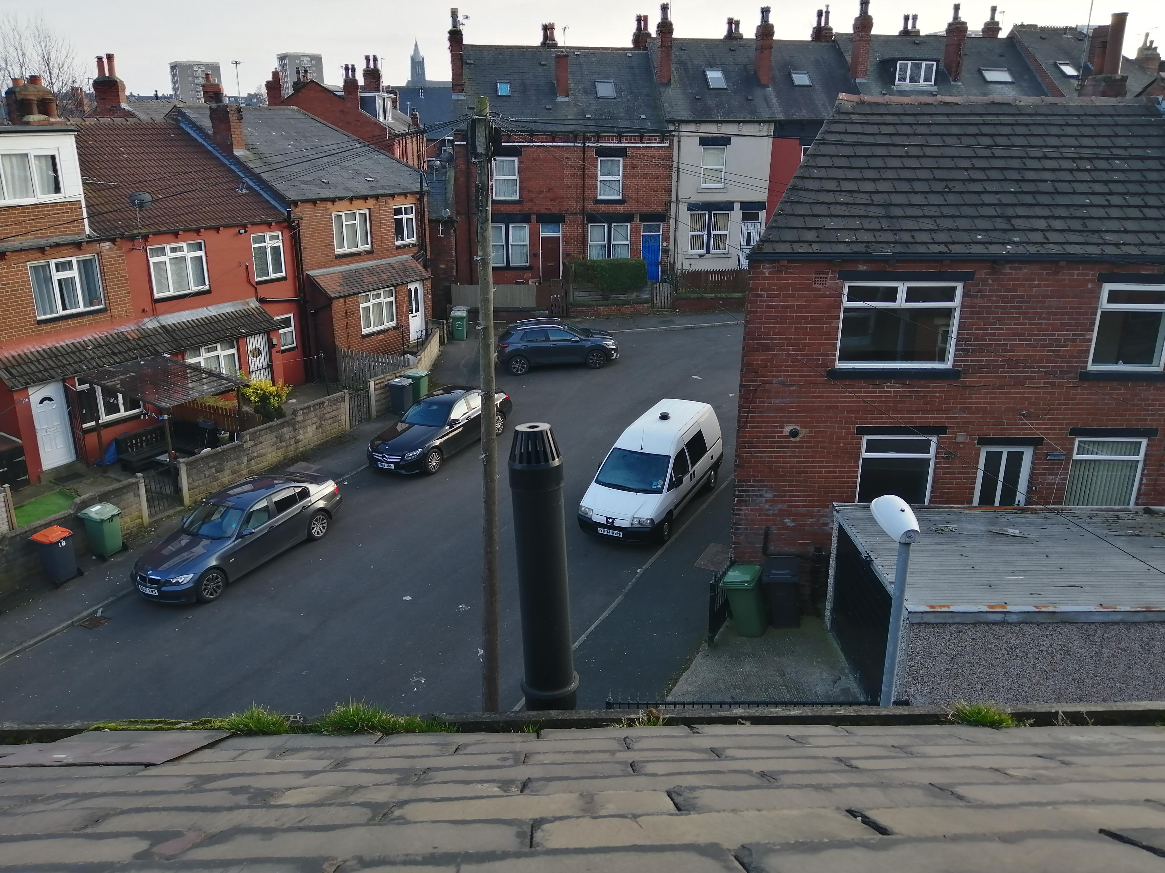
4. Road type and Low Traffic Neighbourhoods – West Yorkshire case study

Slide 23
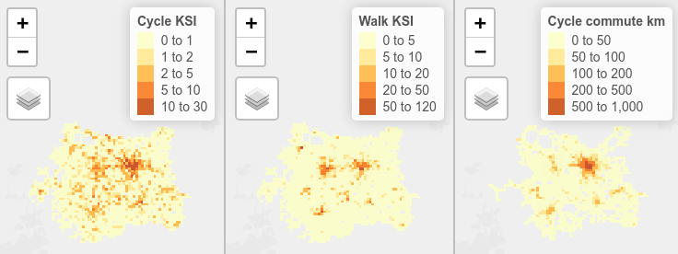
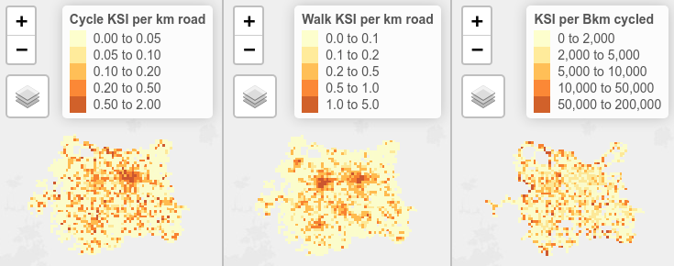
KSI, road length and distance travelled
Notes:
The first two maps only show 1km grid cells that contain a road (excl. motorways). The third map only shows cells that are on the PCT route network. KSI are all day, 2010-2019 (to maximise available data). Cycle commute km are one-way on a single day. High KSI on the pennine fringes are probably an artefact of leisure/sport cycling dominance

Slide 24
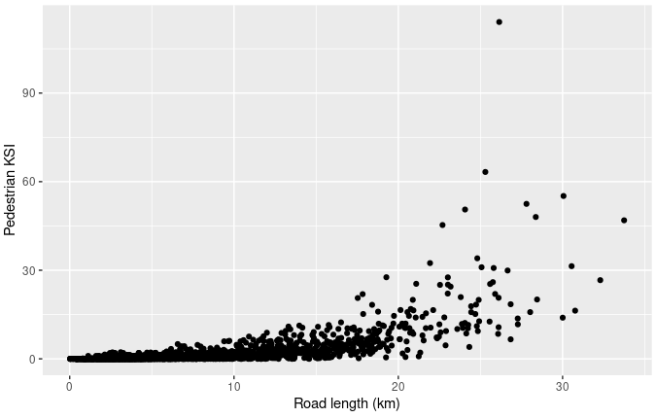
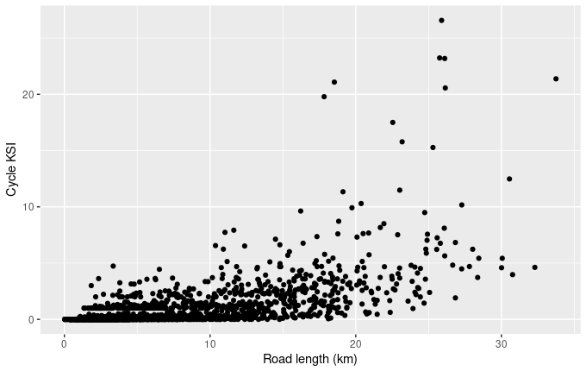
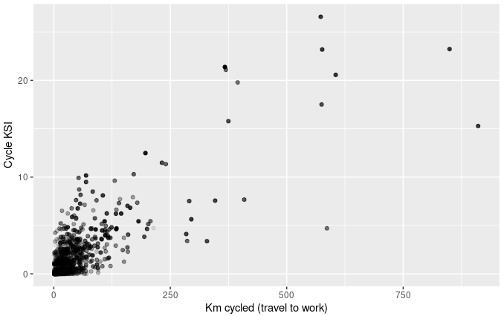
KSI, road length and distance travelled

Slide 25
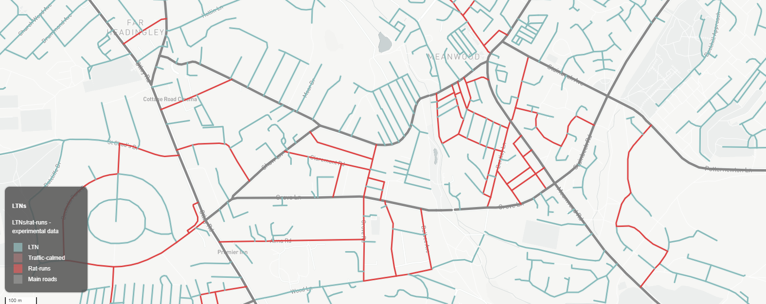
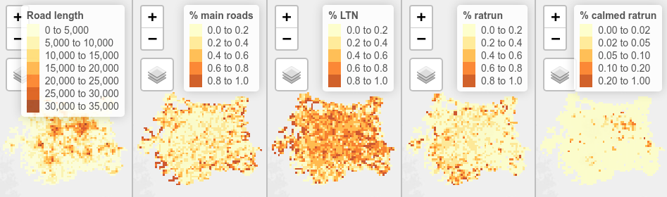
Proportions of different road types
Notes:
Note the different scale for calmed ratruns.

Slide 26
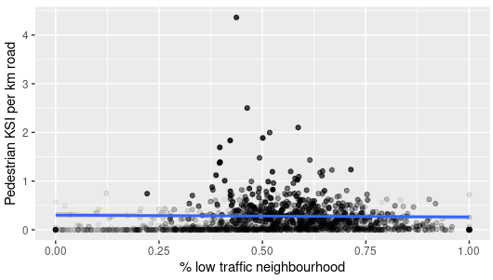
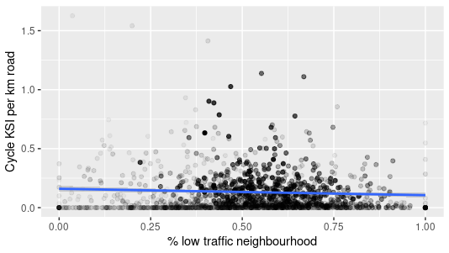
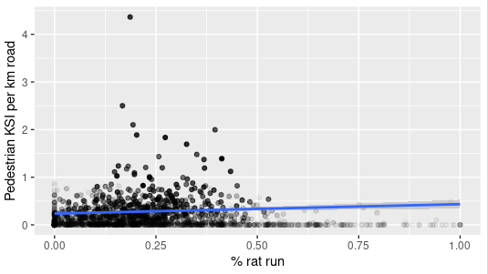
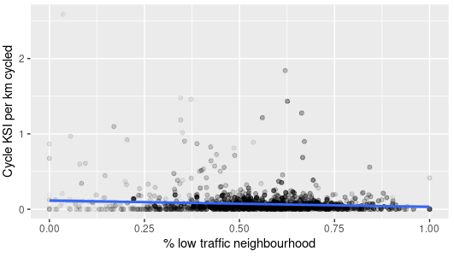
KSI and road type
Notes:
GAM trend lines added.

Slide 27
5. Conclusions
When assessing road safety, it’s vital to recognise the role of the denominator in determining risk
There is no single source of truth when it comes to distance travelled – different sources give different results
Cycle safety appears to be improving – both in the years preceding 2019 and in 2019-2020
These trends vary across the country, with particular improvements in some regions
Safety in numbers and the effects of urbanisation may influence risk
Road type, including LTNs, may be a contributing factor influencing road safety

